Slide 1

MARIO KART 8 OPTIMIZATION

Slide 2

COLON CANCER ANALYSIS

Slide 3
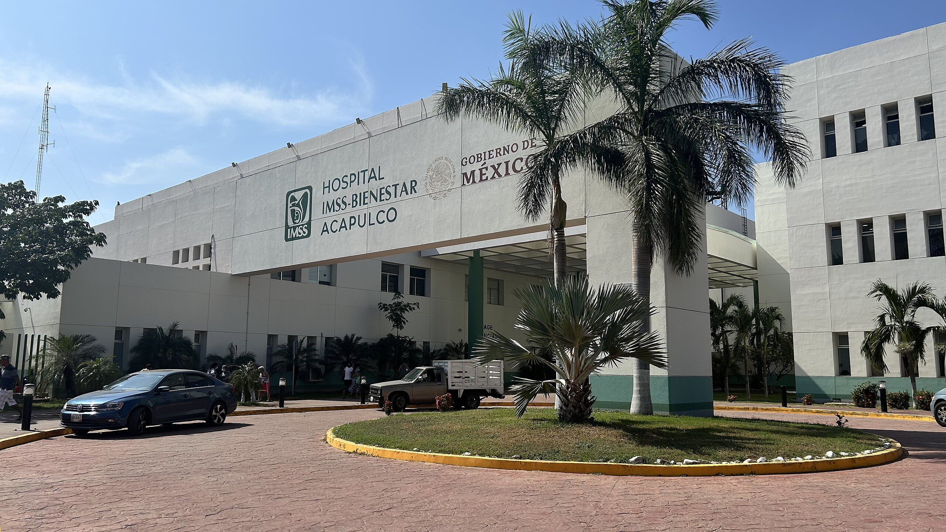
ACCESS TO HEALTH

Slide 4
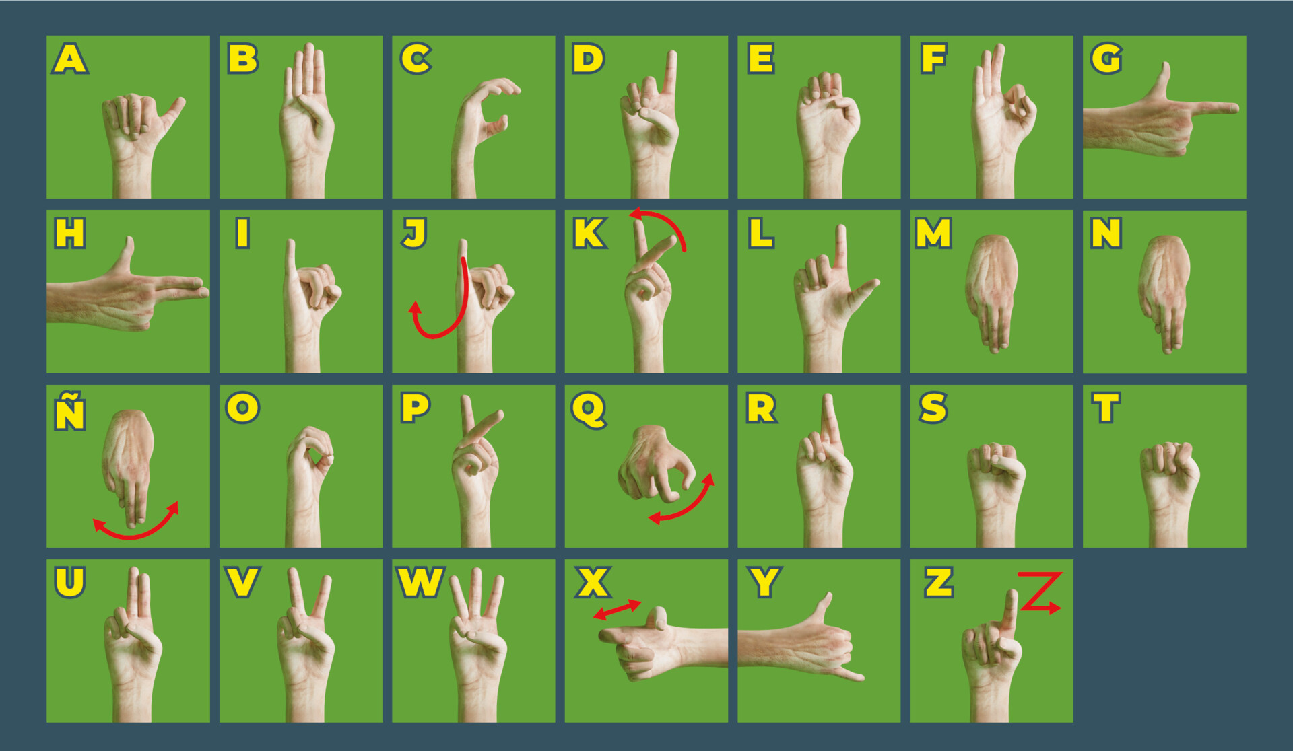
MEXICAN SIGN LANGUAGE

Slide 5
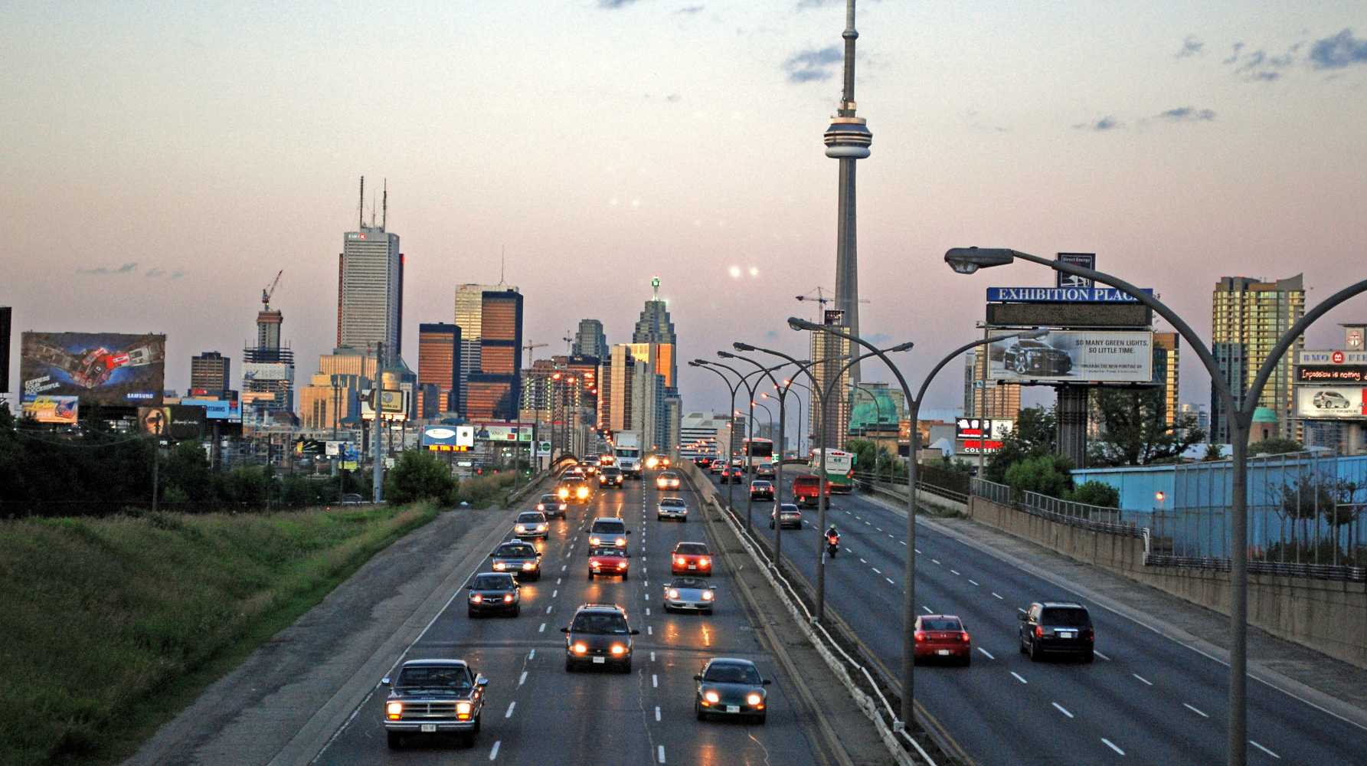
TORONTO SAS SAFE ROADS

Slide 6
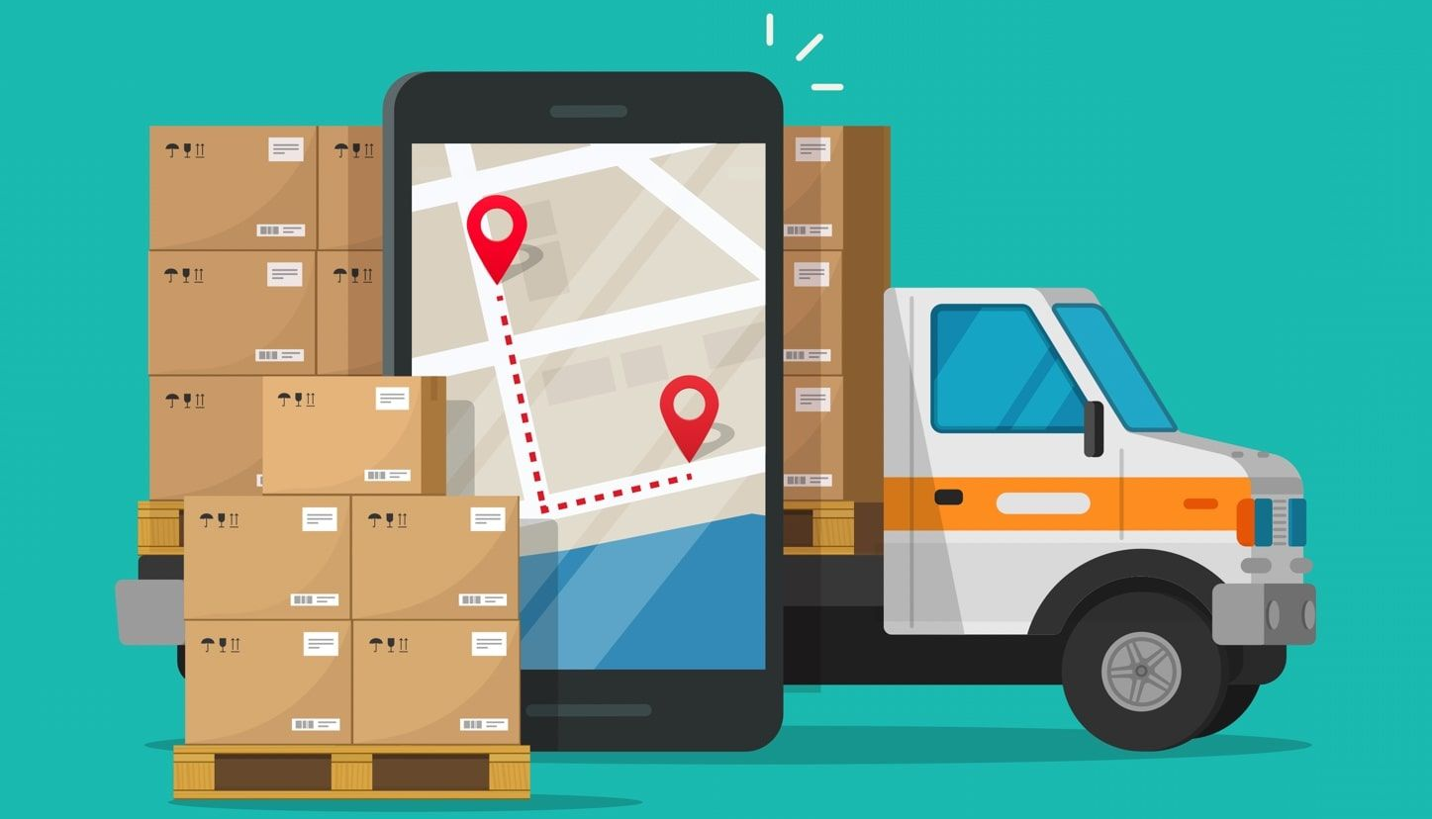
COPPEL ROUTE OPTIMIZATION

Slide 7

DIABETES CLASSIFICATION

Slide 8
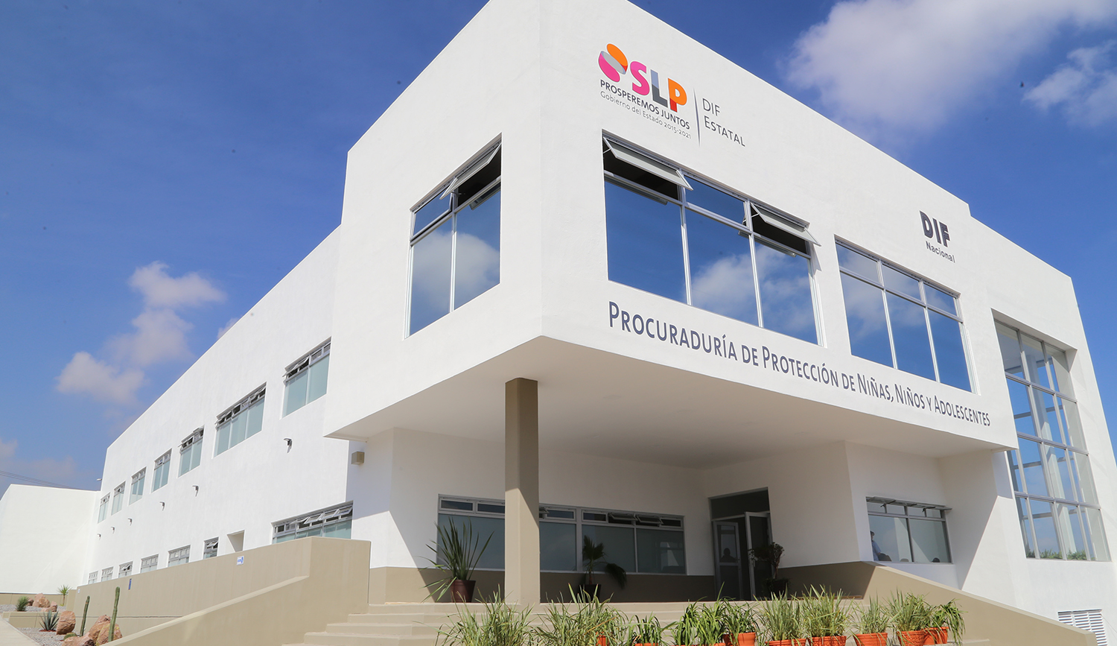
DIF VIOLENCE ANALYSIS

Slide 9
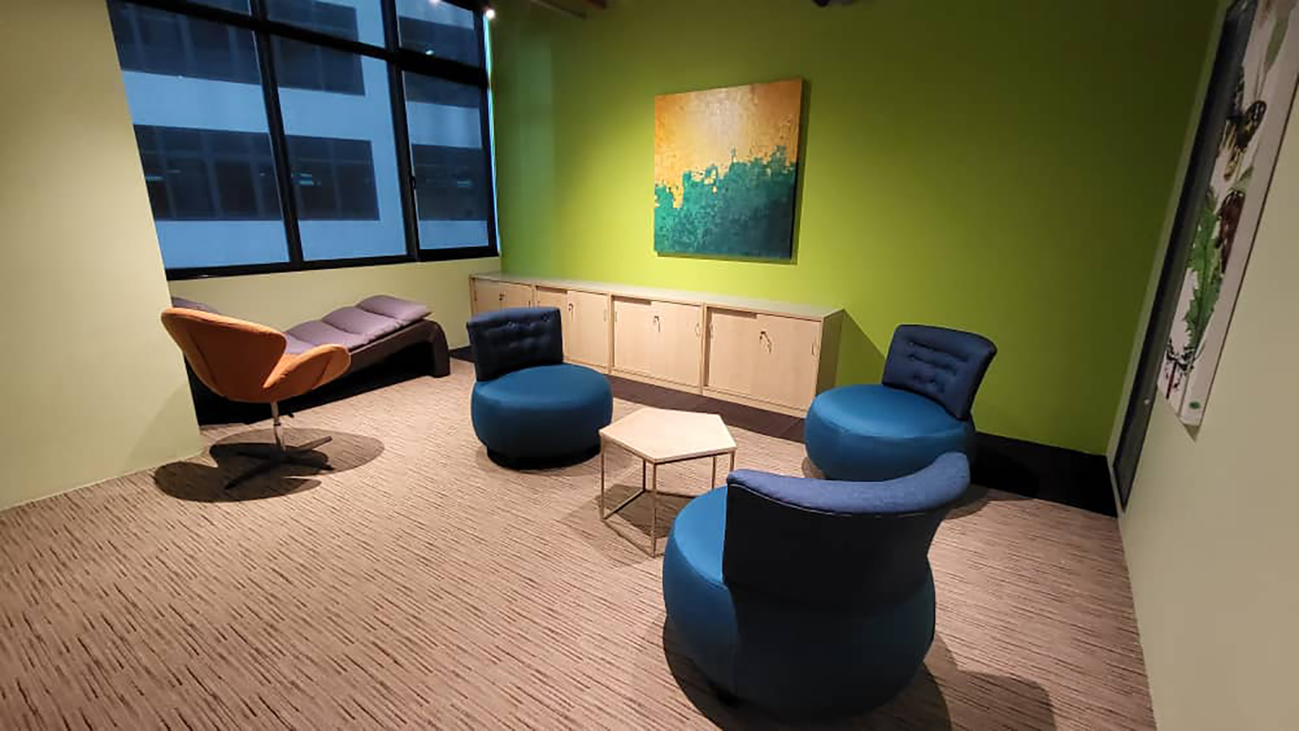
REFLEXION BUDDY

Slide 10

CROP N’
SOIL

Slide 11

SUSTAINABLE
AF

Slide 12

MOVE OUT WITH US

Slide 13

CARBON
CUT

Slide 14
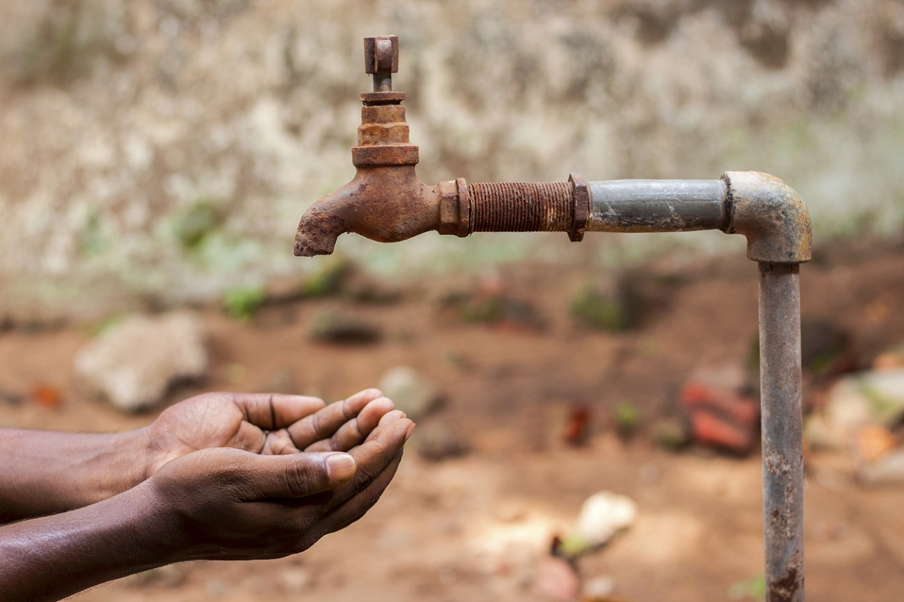
WATER
AI

Slide 15

BANKING CREDIT ANALYSIS

